Slide 1
HAGITAL Data Engineering BootCamp Presentation

Slide 2
DATA ENGINEERING STUDENT
Group Project 6 - Members
Mr. Merua, Goodluck Ozoemela (Leader)
Arch. Olabode, Taiwo Gabriel
Mr. Oyeleke, Oyewale Olutayo
TITLE: Smart Home Energy Monitoring (IoT/Energy)
Date: 29/08/2025

Slide 3
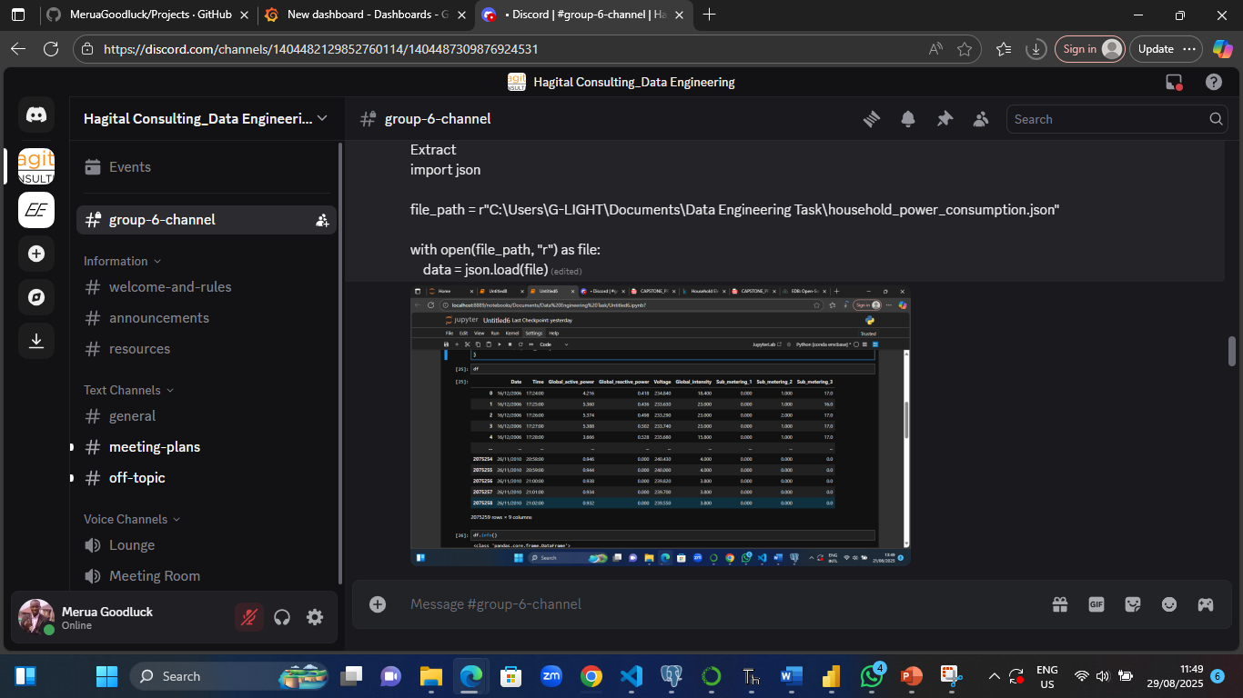
ETL Pipleline Design
Extract: Here is the breakdown of our Task First Step: We downloaded the Household Electric Power Consumption dataset from Kaggle, It has 9 fields which was discussed in the project documentation. We used Python for the ETL (Extract, Transform and Load), here is the breakdown of the ETL process.

Slide 4
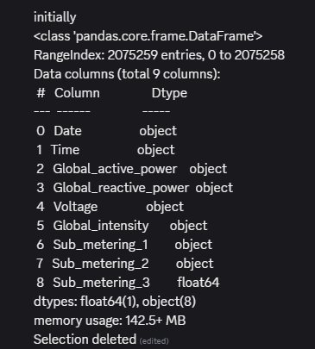
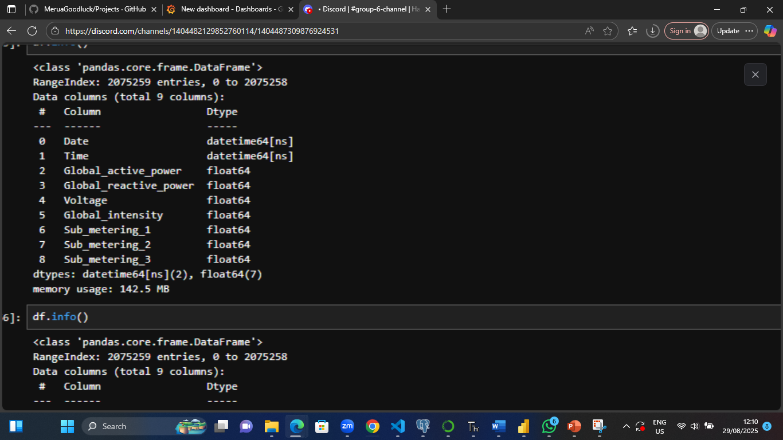
Transformation - The following transformation was done on the dataset, which are changing the Datatype from object to date for the Date field and time format for the Time field to facilitate easy insights on the Date and Time analysis and the other decimal fields was converted to float.
Before Transformation After Transformation

Slide 5
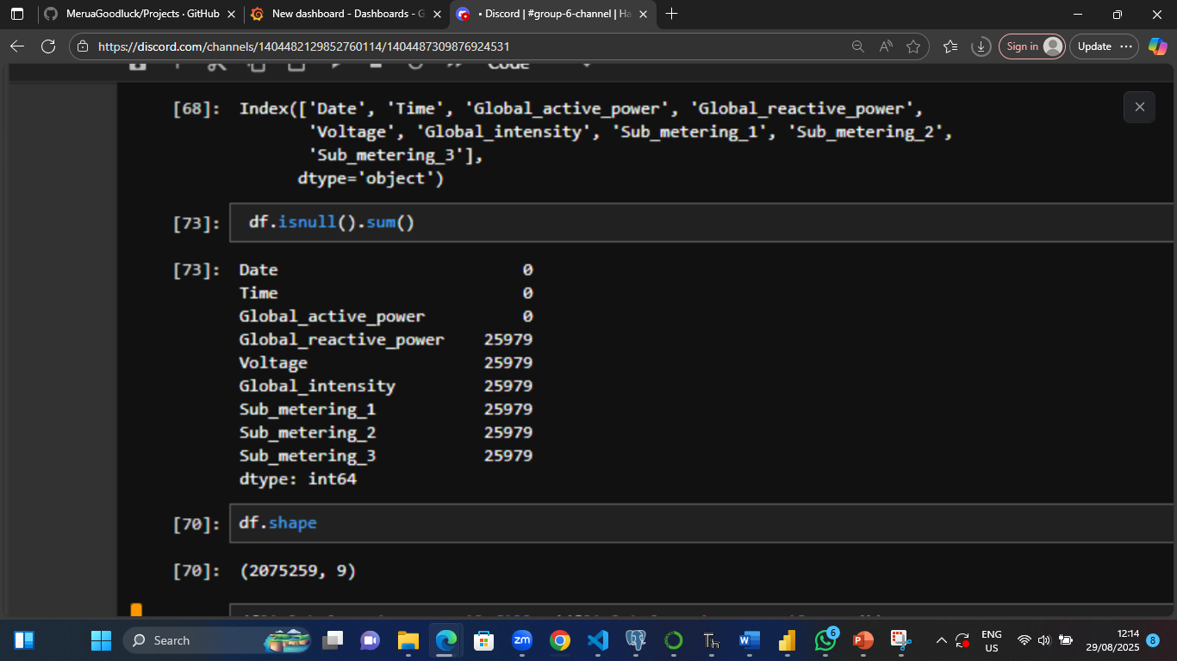
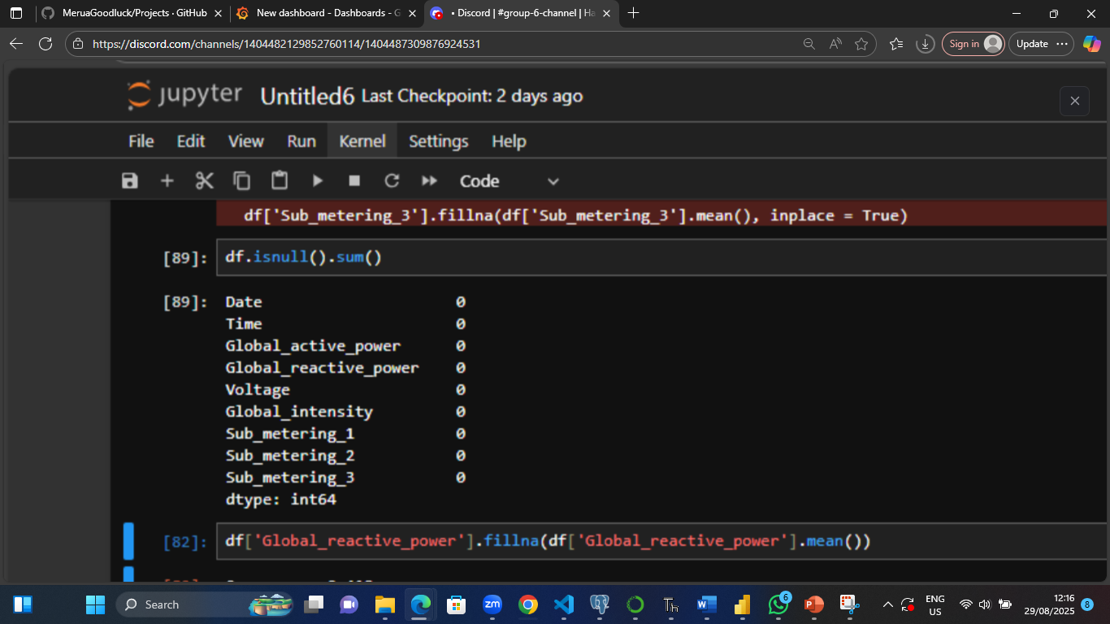
Still on the Transformation, we find-out that out of 2075259 records that 25979 records were missing equally across every fields with Date and Time fields exclusive.
Before Transformation After Transformation

Slide 6
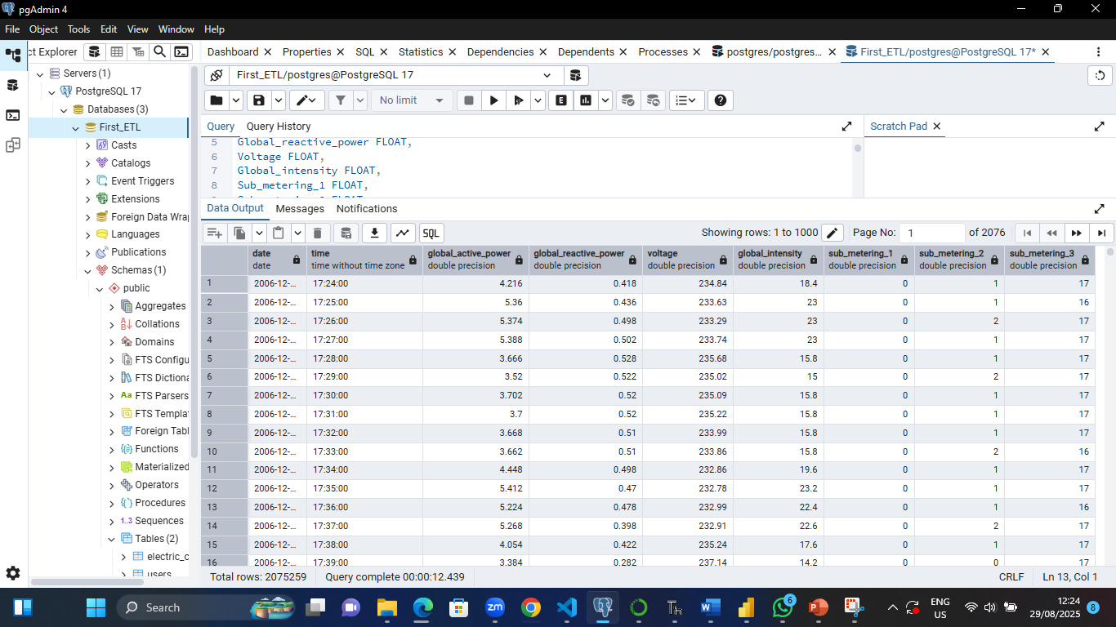
Load: We employed Psycopg2 Python library to create connection and load the dataset from Python to Postgress

Slide 7
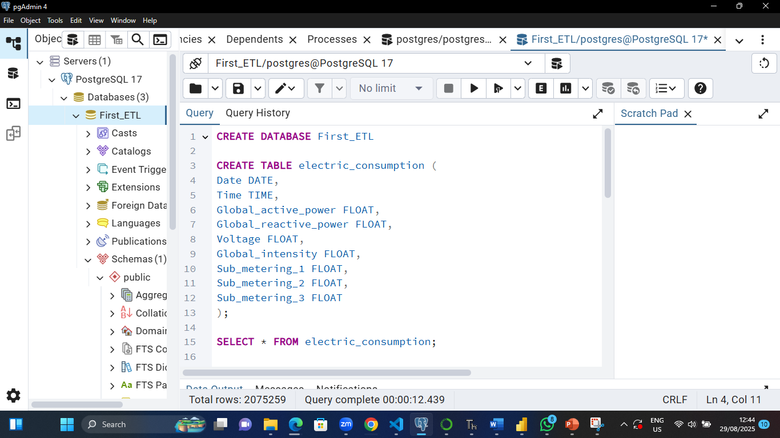
POSTGRESQL Schema
First of all, we created a Postgres Database and finally created the table with their corresponding's fields of the dataset it will contain, like a builder tearing the ground strategically on the structure the foundation will carry on it. Here comes the codes for the database design and table design respectively.

Slide 8
SQL queries used
We five (5) SQL queries for this project, which include the following SQL queries:
Query one: The first query was to fetch the “ Daily average global active power”
Query Two: The second query was to retrieve ‘’the Hourly power usage trend”
Query Three: The third query was to fetch “Monthly power usage”
Query Four: The fourth query was to fetch “Sub-metering contribution”
Query Five: The fifth query was to retrieve “Power factor (efficiency measure)”

Slide 9
Codes employed
-- SQL Code for query 1
SELECT date, AVG(global_active_power) AS avg_power
FROM electric_consumption
GROUP BY date
ORDER BY date;
-- SQL Code for query 2
SELECT EXTRACT(HOUR FROM time) AS hour,
AVG(global_active_power) AS avg_power
FROM electric_consumption
GROUP BY hour
ORDER BY hour;
-- SQL Code for query 3
SELECT EXTRACT(MONTH FROM date) AS month,
AVG(global_active_power) AS avg_power
FROM electric_consumption
GROUP BY month
ORDER BY month;

Slide 10
Codes employed (Cont.)
-- SQL Code for query 4
SELECT date,
SUM(sub_metering_1) AS sm1,
SUM(sub_metering_2) AS sm2,
SUM(sub_metering_3) AS sm3
FROM electric_consumption
GROUP BY date
ORDER BY date;
-- SQL Code for query 5
SELECT date, time,
global_active_power /
SQRT(POWER(global_active_power,2) + POWER(global_reactive_power,2)) AS power_factor
FROM electric_consumption
limit 100;

Slide 11
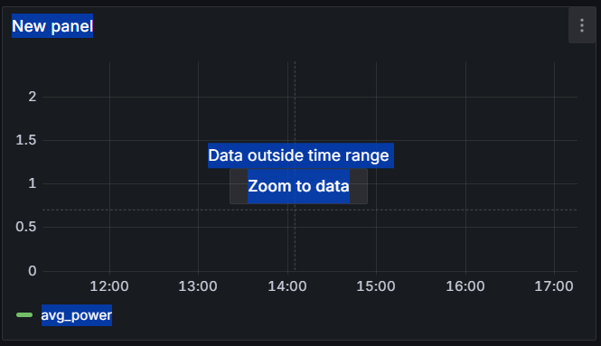
Grafana Dashboards
We will display the graph for the Grafana alongside with Excel graph because we encountered a challenge that the Grafana vitiates when the dataset computed is outside the time range, we see messages like the one below popping-up, which Excel caters for in such case scenario.
Although, we saw the Grafana doing great in data summarization visuals.

Slide 12
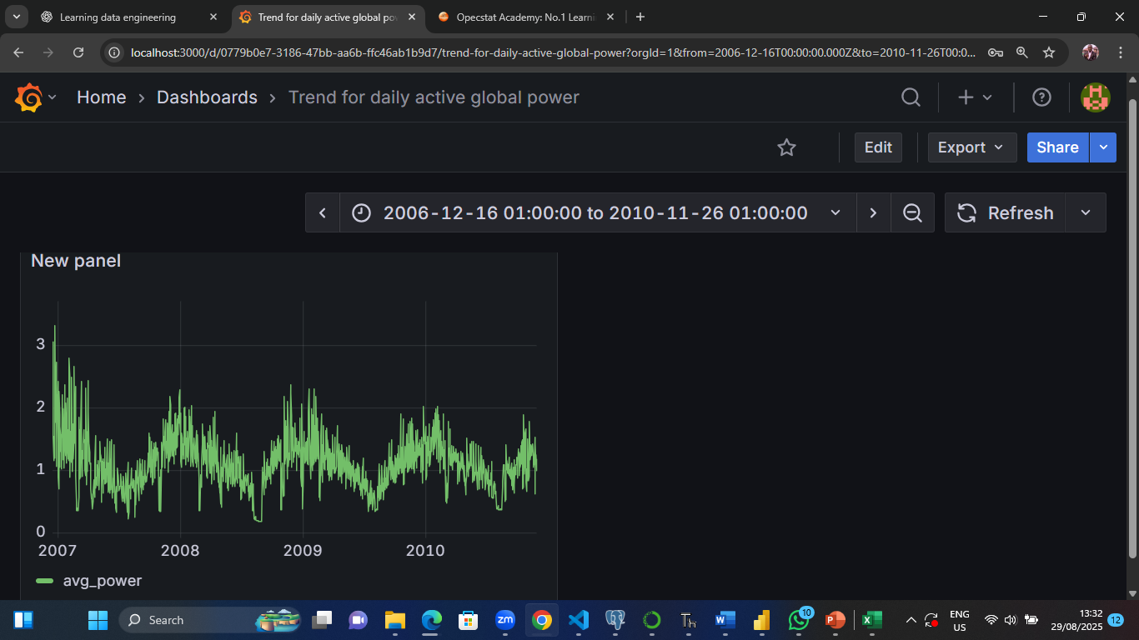
Grafana Dashboards
Dashboard 1: To depict “Daily average global active power”
Insights: The electric company needs to stabilize the global active power to avoid the frequent surge in electric power that can lead to burnout of electric gadgets.

Slide 13
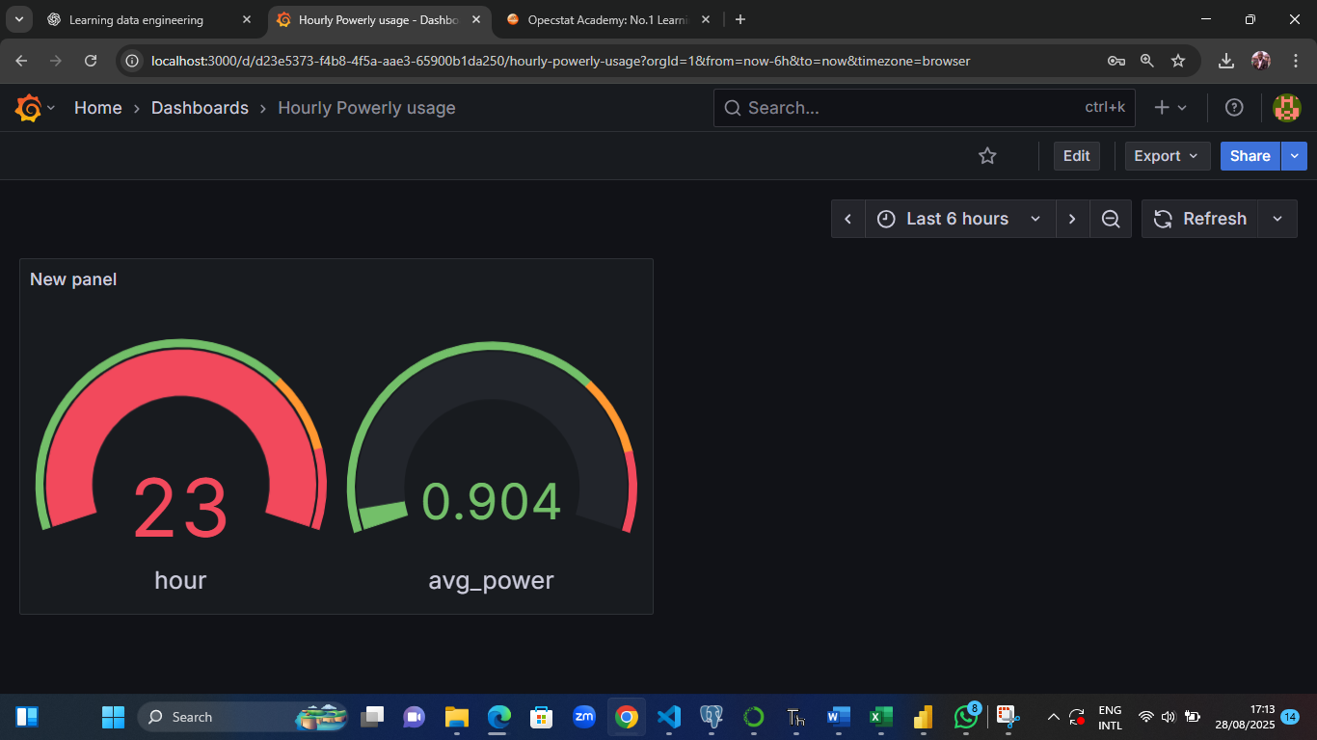
Grafana Dashboards
Dashboard 2: To show hourly power usage trend
Insights: The Power holding company needs to make sure that power is regulated during these rush-hours

Slide 14
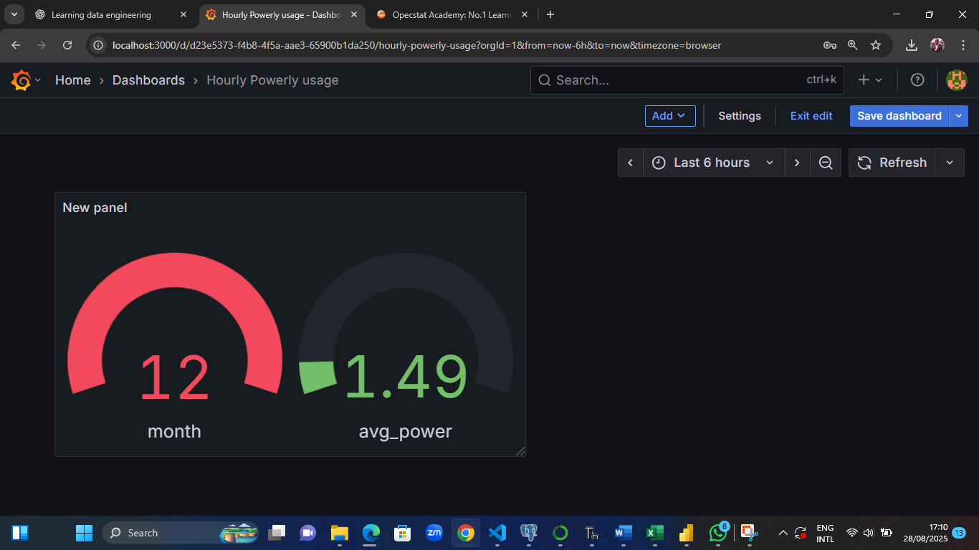
Grafana Dashboards
Dashboard 2: To depict monthly power usage
Insights: The Power holding company needs to be at their best during this period to regulate power utilization and make sure adequate power is supplied to dwellers and visitors during December and January.

Slide 15
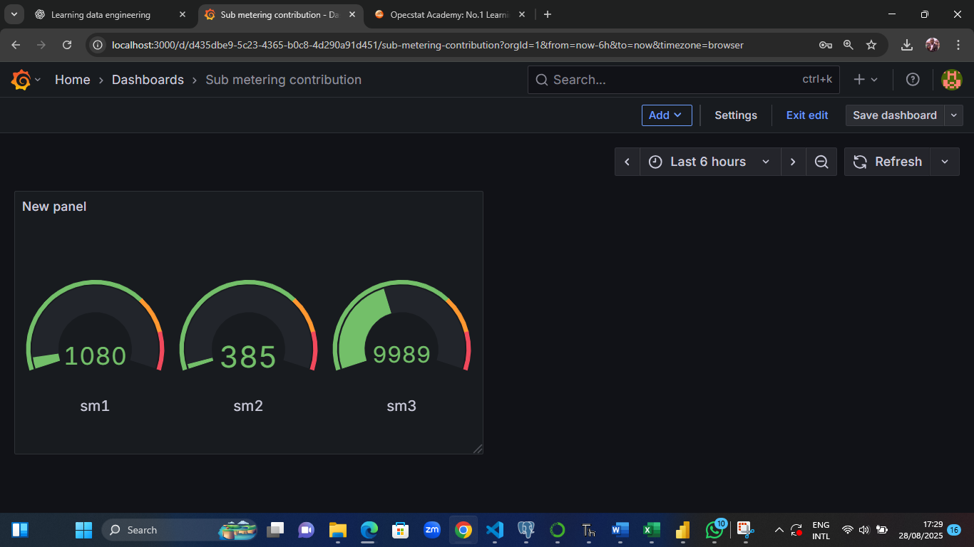
Grafana Dashboards
Dashboard 2: To depict the daily sub-metering contribution
Insights: Those using heavy electric gadgets should subscribe to sub-metering 3 and moderate power consumption to sub-metering 2 and less power consumption to sub-metering 1.

Slide 16
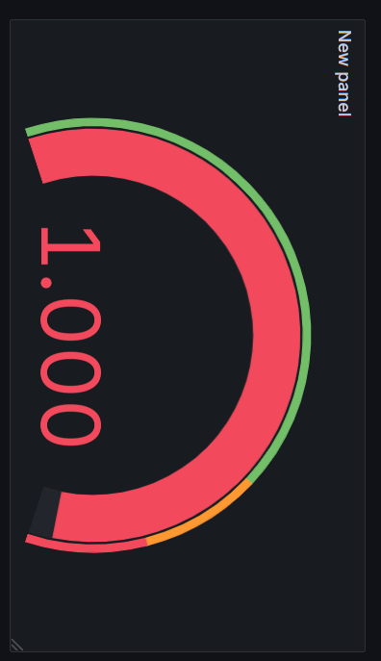
Grafana Dashboards
Dashboard 2: To show measure power efficiency (in minlutes)
Insights: The places of little drops should still be looked into so that we won’t think everything is in order while is already out of control just like what a small variation can do to production plant, so they should still investigate more into it to cater for this slight changes.

Slide 17
Lessons learned
Here are the lessons I learnt from this group project:
I learnt that during a full day that electric current fluctuates and we see many sharp spikes in the peaks and troughs of the electric line which can damage gadgets that are power-demanding, I learnt that during midnights when many people are asleep and not using electricity that much is the best time to switch-on these heavy-power gadgets.
We discovered that during December and January there is peak in the usage of power because visitors coupled with dwellers with various economic activities are swamped excessively during this period, so the power holding company needs to be at their very best during this Yuletide seasons.
Finally, I learnt that even though there was area to improve but the power holding company was excellent overall in disseminating power to various locales under jurisdiction.

Slide 18
Recommendations
From the analyses carry-out in this project work, we recommend that the datasets on devices and locations should be worked upon so that we can draw our Entity-Relationship diagrams, it will enable us to compare and contrast amongst them like which location consumes more electricity power amongst others; Which household gadgets are more power-demanding amongst others, which is particular location has more devices and a particular household gadget(s) are located there et cetera.
Hence, making more powerful insights across devices, locations and readings.

Slide 19
Thank You

